Slide 1
4
Nguyen Thi Huong
English

Slide 2
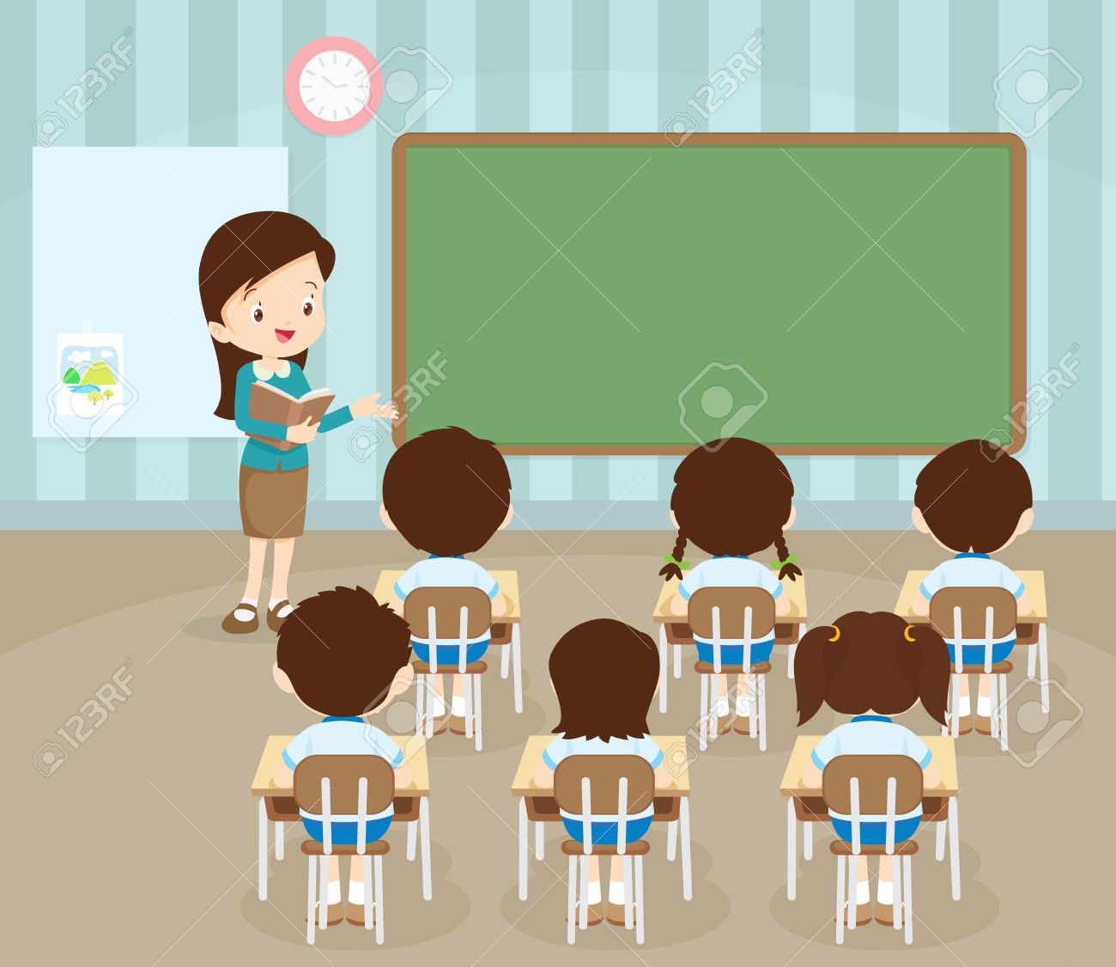
Unit 8 I'd like a melon
lesson one Words
P. 58

Slide 3
Listen and repeat.

Slide 4
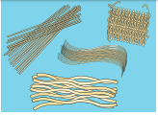
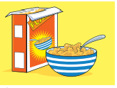
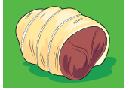
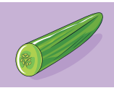
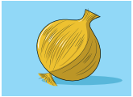
nooles
cereal
meat
melon
cucumber
onion
lemon

Slide 5
1.Listen, point, and repeat.

Slide 6
nooles
cereal
meat
melon
cucumber
onion
lemon

Slide 7
2. Listen and read.

Slide 8
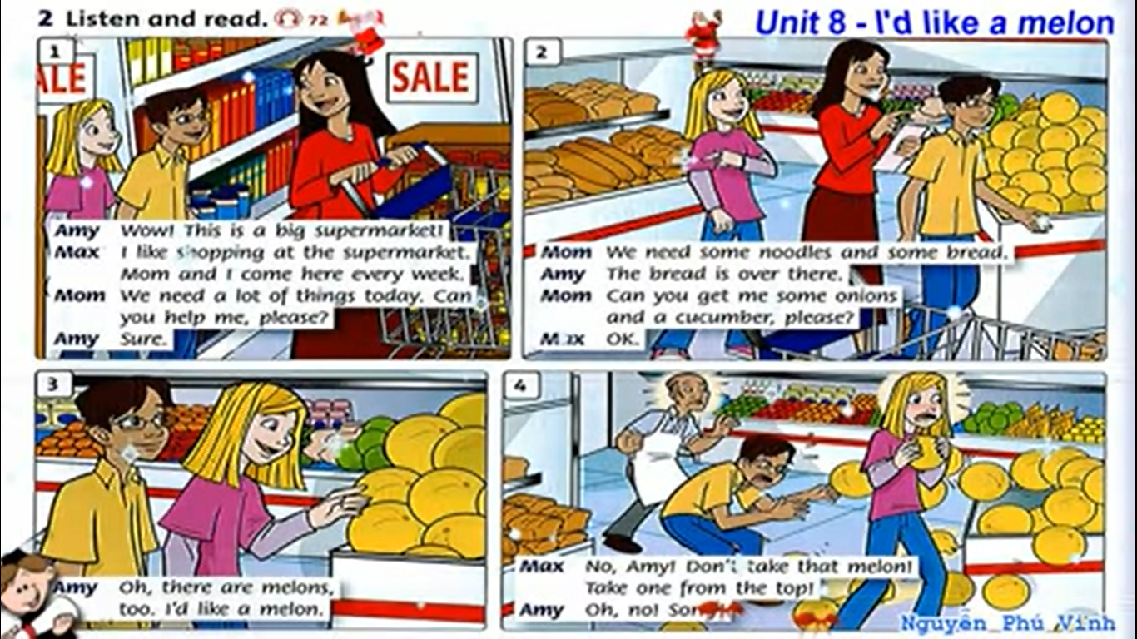

Slide 13
Listen again and answer the question.

Slide 15
1. Where are they ?
1. They are at the supermaket.

Slide 16
2. What does mom need ?
2. Mom needs some noodles, bread, onion and a cucumber.

Slide 17
3. What would Amy like?
3. She'd like a melon.

Slide 18
THANK YOU FOR WATCHING!
- Please write each words nine times.
- Learn words by heart.
- Do your homework. < p. 54>

